Slide 1
The features of the Femtosecond Laser system flap creation process on the eye after radial keratotomy
Case report No financial interest
O.F. Ziiatdinova, L. N. Safiullina Eye surgery “Rascheskov”, Kazan, Russia

Slide 2
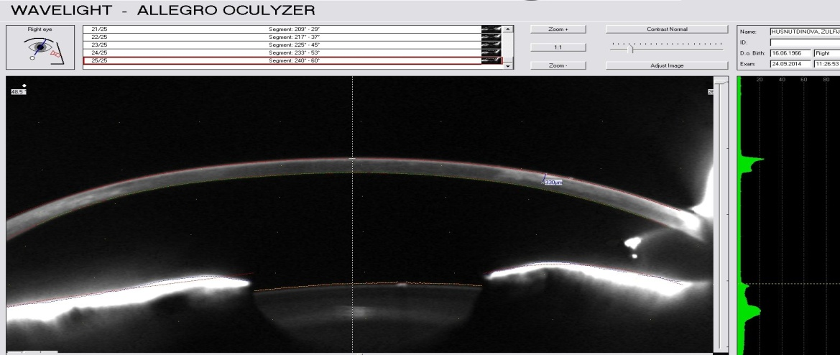
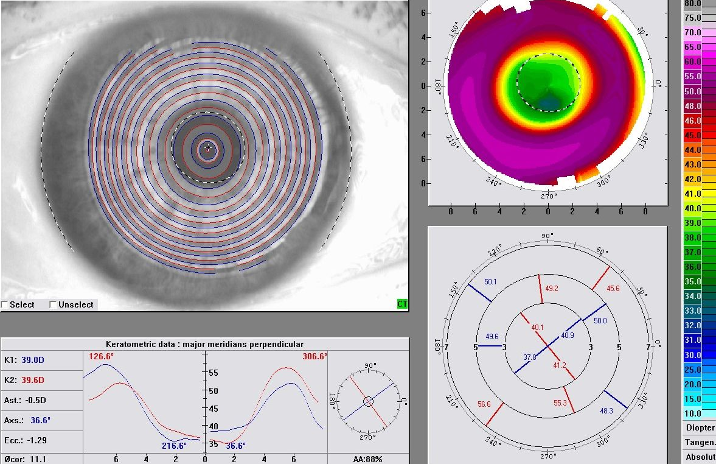
METHODS
A 40-year-old woman underwent customized topography-guided Femtosecond LASIK surgery on the right eye 25 years after 8-cut radial keratotomy (RK) on both eyes for myopia.
Visual acuity OD: 0,16 sph +3,0 cyl -0.75 ax 89 = 0,5
The cuts have medium intensity and the depth about 330 mkm.
330 mkm

Slide 3
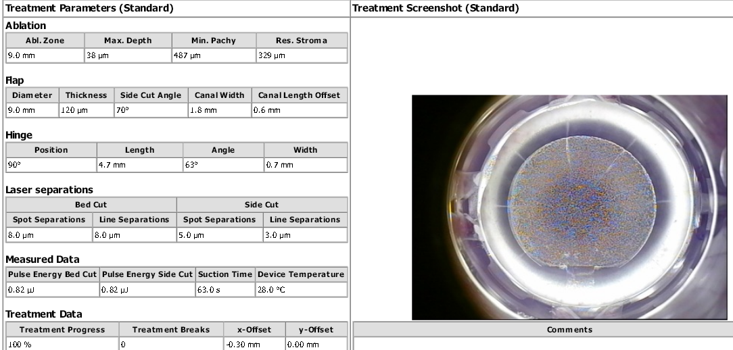
RESULTS
The WaveLight FS 200 Femtosecond Laser (Alcon) was used to create LASIK flap.
The flap parameters :diameter 9 mm, 12 o’clock hinge, 70 degrees side cuts and the depth 120 mkm.
The WaveLight EX500 Excimer Laser was used to perform the customized topography-guided ablation in the eye after the initial RK.

Slide 4
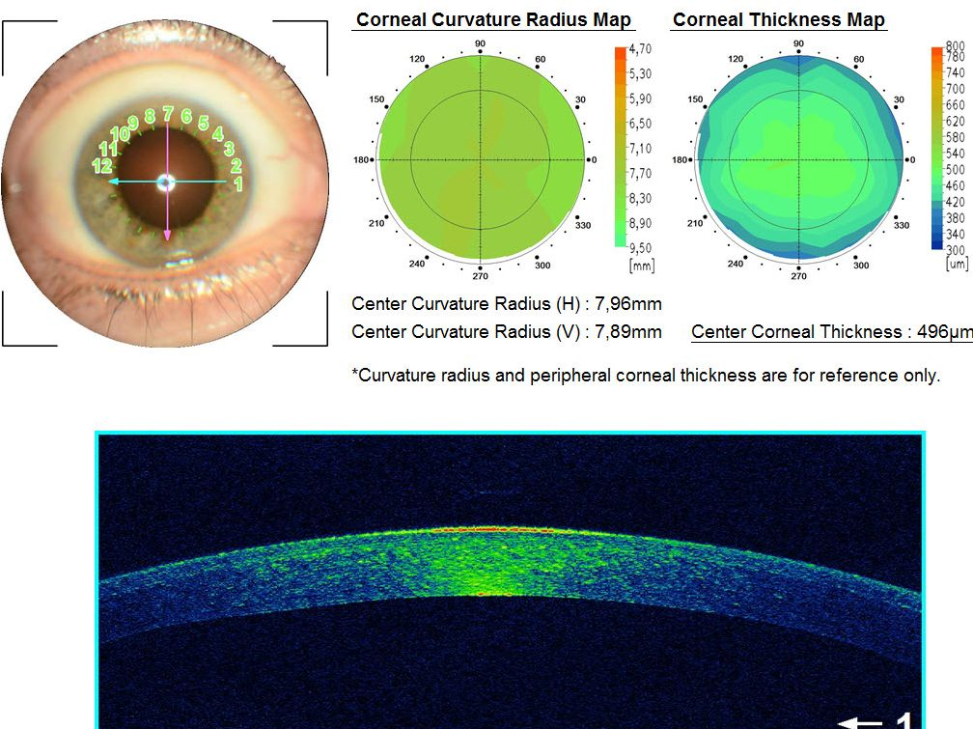
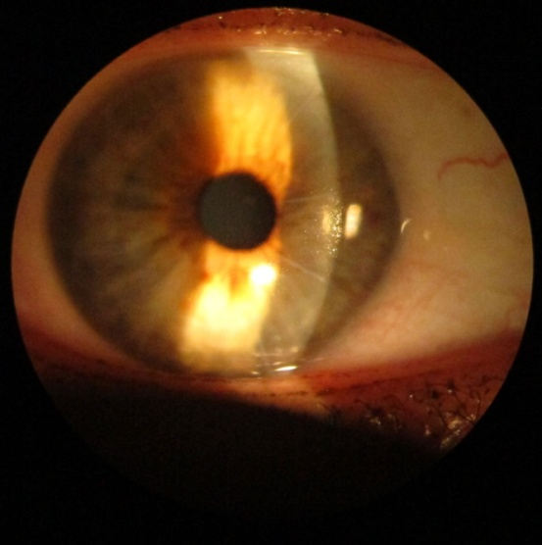
No intra- or postoperative complications were observed. The docking into the eye and Femtosecond Laser system flap creation process went smoothly.
The flap lifting and reposition were also with standard technique. The flap subjectively had regular thickness.

Slide 5
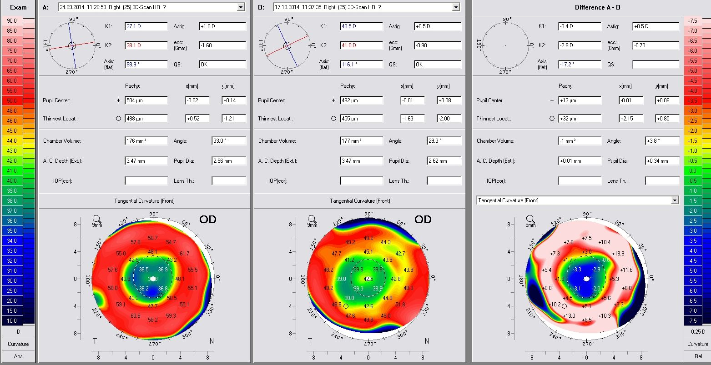
Study results showed that the eye after 8-cut RK with medium intensity scars could not have complications with Femtosecond Laser system flap creation process. The flap could be regular and would not have problems with lifting and reposition.
Visual acuity OD two weeks after operation : 0,8
Compare maps before and after operation

Slide 6
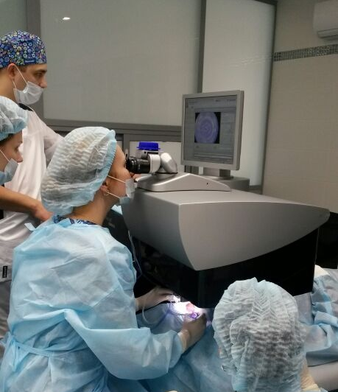
CONCLUSIONS
Femtosecond flap LASIK procedure could be used for correct refractive errors in eyes with previous radial keratotomy. The corneal flap lifting requires accuracy with separation from the stromal bed.
Creating the flap with the Femtosecond Laser, flap lifting and reposition in eye after 8-cut RKT with medium intensity scars and the depth until 330 mkm would performed within standard technique.
Thank you for your attention!

